Slide 1
Broadcom Development Platform: Digole LCD Display
By: Jacob Ladan
Blog: https://jacobladan.github.io/Digole-LCD-Display/

Slide 2
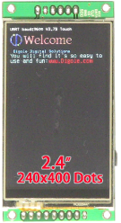
Introduction
2.4” Colour LCD Display with Touchscreen Capabilities
400 x 240 resolution
Used alongside an RFID chip/reader to implement a user interface when accessing rooms/work areas
Displays room information (room number, schedule, current occupants, etc.)

Slide 3
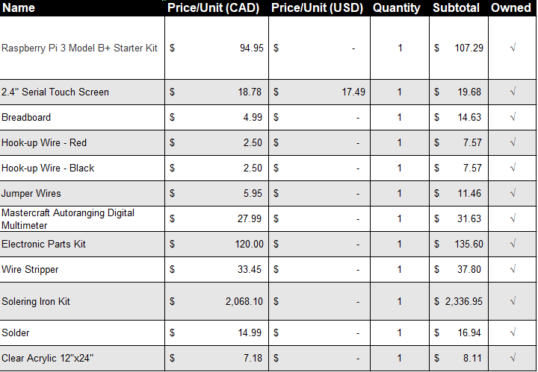
Budget: Breakdown

Slide 4
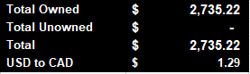
Budget: Summary

Slide 5
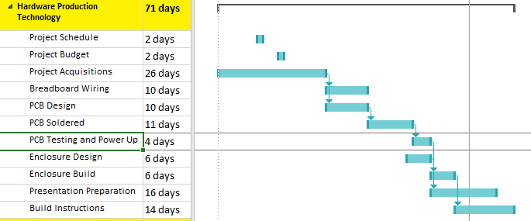
Schedule: Gantt

Slide 6
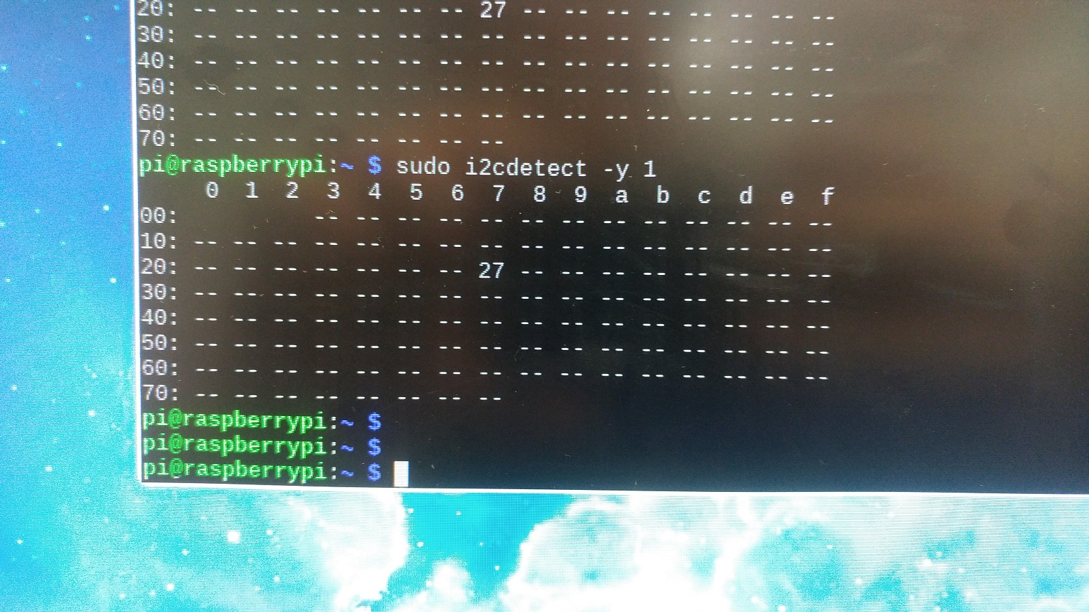
I2C Hardware Address (0x27)

Slide 7
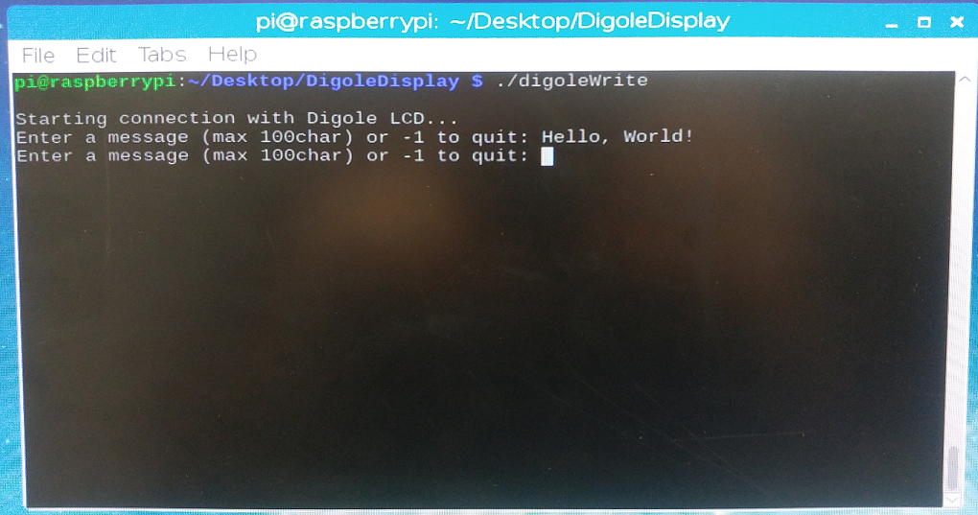
Writing to the LCD (Input)

Slide 8
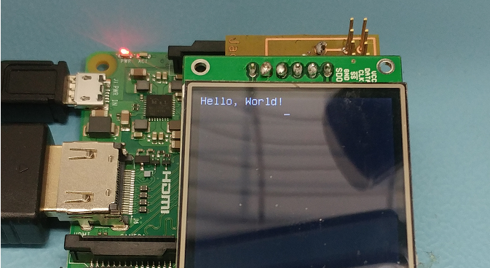
Writing to the LCD (Output)

Slide 9
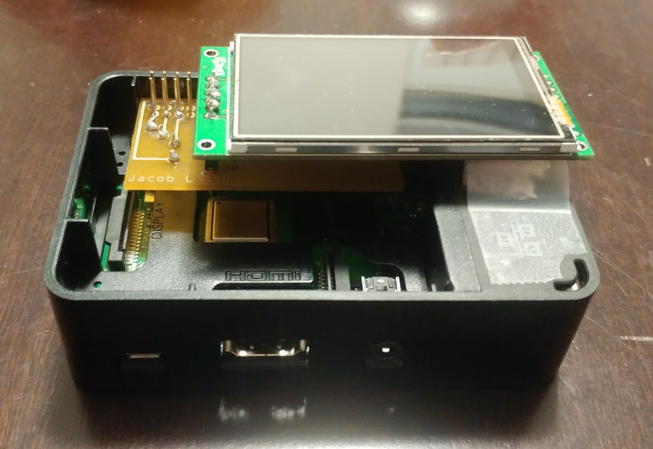
Working Prototype

Slide 10

Course Knowledge
Technical C (TECH 153) / Embedded Systems (CENG 252)
C Programming
I2C
Raspberry Pi/Linux Environment
Digital and Interface Systems (CENG 215)
Breadboarding
Electronics Hardware

Slide 11
Thank You

